Slide 1
Chapter 3: SQL

Slide 2
Chapter 3: SQL
Data Definition
Basic Query Structure
Set Operations
Aggregate Functions
Null Values
Nested Subqueries
Complex Queries
Views
Modification of the Database
Joined Relations**
Notes:
1

Slide 3
History
IBM Sequel language developed as part of System R project at the IBM San Jose Research Laboratory
Renamed Structured Query Language (SQL)
ANSI and ISO standard SQL:
SQL-86
SQL-89
SQL-92
SQL:1999 (language name became Y2K compliant!)
SQL:2003
Commercial systems offer most, if not all, SQL-92 features, plus varying feature sets from later standards and special proprietary features.
Not all examples here may work on your particular system.

Slide 4
Data Definition Language
Allows the specification of:
The schema for each relation, including attribute types.
Integrity constraints
Authorization information for each relation.
Non-standard SQL extensions also allow specification of
The set of indices to be maintained for each relations.
The physical storage structure of each relation on disk.

Slide 5
Create Table Construct
An SQL relation is defined using the create table command:
create table r (A₁ D₁, A₂ D₂, ..., A_{n} D_{n}, (integrity-constraint₁), ..., (integrity-constraint_{k}))
r is the name of the relation
each A_{i} is an attribute name in the schema of relation r
D_{i} is the data type of attribute A_{i}
Example:
create table branch (branch_name char(15), branch_city char(30), assets integer)

Slide 6
Domain Types in SQL
char(n). Fixed length character string, with user-specified length n.
varchar(n). Variable length character strings, with user-specified maximum length n.
int. Integer (a finite subset of the integers that is machine-dependent).
smallint. Small integer (a machine-dependent subset of the integer domain type).
numeric(p,d). Fixed point number, with user-specified precision of p digits, with n digits to the right of decimal point.
real, double precision. Floating point and double-precision floating point numbers, with machine-dependent precision.
float(n). Floating point number, with user-specified precision of at least n digits.
More are covered in Chapter 4.

Slide 7
Integrity Constraints on Tables
not null
primary key (A₁, ..., A_{n} )
Example: Declare branch_name as the primary key for branch
.
create table branch (branch_name char(15), branch_city char(30) not null, assets integer, primary key (branch_name))
primary key declaration on an attribute automatically ensures not null in SQL-92 onwards, needs to be explicitly stated in SQL-89

Slide 8
Basic Insertion and Deletion of Tuples
Newly created table is empty
Add a new tuple to account
insert into account values ('A-9732', 'Perryridge', 1200)
Insertion fails if any integrity constraint is violated
Delete all tuples from account
delete from account
Note: Will see later how to delete selected tuples

Slide 9
Drop and Alter Table Constructs
The drop table command deletes all information about the dropped relation from the database.
The alter table command is used to add attributes to an existing relation:
alter table r add A D
where A is the name of the attribute to be added to relation r and D is the domain of A.
All tuples in the relation are assigned null as the value for the new attribute.
The alter table command can also be used to drop attributes of a relation:
alter table r drop A
where A is the name of an attribute of relation r
Dropping of attributes not supported by many databases

Slide 10
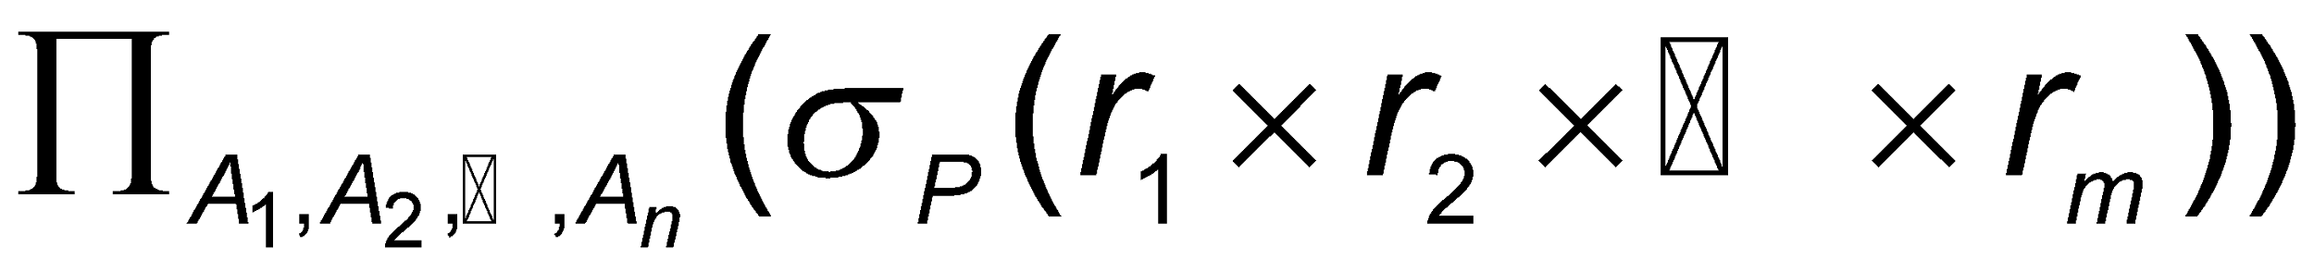
Basic Query Structure
A typical SQL query has the form: select A₁, A₂, ..., A_{n} from r₁, r₂, ..., r_{m} where P
A_{i} represents an attribute
R_{i} represents a relation
P is a predicate.
This query is equivalent to the relational algebra expression.
The result of an SQL query is a relation.
Notes:
2

Slide 11
The select Clause
The select clause list the attributes desired in the result of a query
corresponds to the projection operation of the relational algebra
Example: find the names of all branches in the loan relation: select branch_name from loan
In the relational algebra, the query would be:
∏_{branch_name} (loan)
NOTE: SQL names are case insensitive (i.e., you may use upper- or lower-case letters.)
E.g. Branch_Name ≡ BRANCH_NAME ≡ branch_name
Some people use upper case wherever we use bold font.
Notes:
3

Slide 12
The select Clause (Cont.)
SQL allows duplicates in relations as well as in query results.
To force the elimination of duplicates, insert the keyword distinct after select.
Find the names of all branches in the loan relations, and remove duplicates
select distinct branch_name from loan
The keyword all specifies that duplicates not be removed.
select all branch_name from loan
Notes:
4

Slide 13
The select Clause (Cont.)
An asterisk in the select clause denotes “all attributes”
select * from loan
The select clause can contain arithmetic expressions involving the operation, +, –, *, and /, and operating on constants or attributes of tuples.
E.g.:
select loan_number, branch_name, amount * 100 from loan
Notes:
5

Slide 14
The where Clause
The where clause specifies conditions that the result must satisfy
Corresponds to the selection predicate of the relational algebra.
To find all loan number for loans made at the Perryridge branch with loan amounts greater than $1200.
select loan_number from loan where branch_name = 'Perryridge' and amount > 1200
Comparison results can be combined using the logical connectives and, or, and not.
Notes:
6

Slide 15
The from Clause
The from clause lists the relations involved in the query
Corresponds to the Cartesian product operation of the relational algebra.
Find the Cartesian product borrower X loan
select * from borrower, loan
Find the name, loan number and loan amount of all customers having a loan at the Perryridge branch.
select customer_name, borrower.loan_number, amount from borrower, loan where borrower.loan_number = loan.loan_number and branch_name = 'Perryridge'
Notes:
8

Slide 16
The Rename Operation
SQL allows renaming relations and attributes using the as clause:
old-name as new-name
E.g. Find the name, loan number and loan amount of all customers; rename the column name loan_number as loan_id.
select customer_name, borrower.loan_number as loan_id, amount from borrower, loan where borrower.loan_number = loan.loan_number
Notes:
9

Slide 17
Tuple Variables
Tuple variables are defined in the from clause via the use of the as clause.
Find the customer names and their loan numbers and amount for all customers having a loan at some branch.
select customer_name, T.loan_number, S.amount from borrower as T, loan as S where T.loan_number = S.loan_number
Find the names of all branches that have greater assets than some branch located in Brooklyn.
select distinct T.branch_name from branch as T, branch as S where T.assets > S.assets and S.branch_city = 'Brooklyn'
Keyword as is optional and may be omitted borrower as T ≡ borrower T
Some database such as Oracle require as to be omitted
Notes:
10

Slide 18
String Operations
SQL includes a string-matching operator for comparisons on character strings. The operator “like” uses patterns that are described using two special characters:
percent (%). The % character matches any substring.
underscore (_). The _ character matches any character.
Find the names of all customers whose street includes the substring “Main”.
select customer_name from customer where customer_street like '% Main%'
Match the name “Main%”
like 'Main\%' escape '\'
SQL supports a variety of string operations such as
concatenation (using “||”)
converting from upper to lower case (and vice versa)
finding string length, extracting substrings, etc.

Slide 19
Ordering the Display of Tuples
List in alphabetic order the names of all customers having a loan in Perryridge branch
select distinct customer_name from borrower, loan where borrower loan_number = loan.loan_number and branch_name = 'Perryridge' order by customer_name
We may specify desc for descending order or asc for ascending order, for each attribute; ascending order is the default.
Example: order by customer_name desc

Slide 20
Duplicates
In relations with duplicates, SQL can define how many copies of tuples appear in the result.
Multiset versions of some of the relational algebra operators – given multiset relations r₁ and r₂:
1. σ_{θ} (r₁): If there are c₁ copies of tuple t₁ in r₁, and t₁ satisfies selections σ_{θ,}, then there are c₁ copies of t₁ in σ_{θ} (r₁).
2. Π_{A} (r ): For each copy of tuple t₁ in r₁, there is a copy of tuple Π_{A} (t₁) in Π_{A} (r₁) where Π_{A} (t₁) denotes the projection of the single tuple t₁.
3. r₁ x r₂ : If there are c₁ copies of tuple t₁ in r₁ and c₂ copies of tuple t₂ in r₂, there are c₁ x c₂ copies of the tuple t₁. t₂ in r₁ x r₂

Slide 21
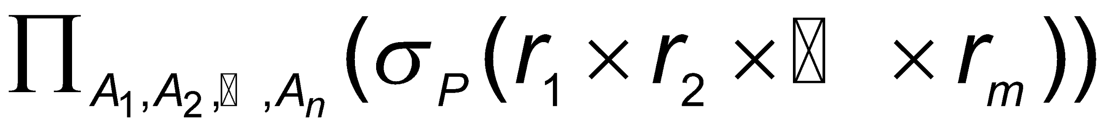
Duplicates (Cont.)
Example: Suppose multiset relations r₁ (A, B) and r₂ (C) are as follows:
r₁ = {(1, a) (2,a)} r₂ = {(2), (3), (3)}
Then Π_{B}(r₁) would be {(a), (a)}, while Π_{B}(r₁) x r₂ would be
{(a,2), (a,2), (a,3), (a,3), (a,3), (a,3)}
SQL duplicate semantics:
select A₁,, A₂, ..., A_{n} from r₁, r₂, ..., r_{m} where P
is equivalent to the multiset version of the expression:

Slide 22
Set Operations
The set operations union, intersect, and except operate on relations and correspond to the relational algebra operations ∪, ∩, −.
Each of the above operations automatically eliminates duplicates; to retain all duplicates use the corresponding multiset versions union all, intersect all and except all. Suppose a tuple occurs m times in r and n times in s, then, it occurs:
m + n times in r union all s
min(m,n) times in r intersect all s
max(0, m – n) times in r except all s

Slide 23
Set Operations
Find all customers who have a loan, an account, or both:
(select customer_name from depositor) union (select customer_name from borrower)
Find all customers who have both a loan and an account.
(select customer_name from depositor) intersect (select customer_name from borrower)
Find all customers who have an account but no loan.
(select customer_name from depositor) except (select customer_name from borrower)

Slide 24
Aggregate Functions
These functions operate on the multiset of values of a column of a relation, and return a value
avg: average value min: minimum value max: maximum value sum: sum of values count: number of values

Slide 25
Aggregate Functions (Cont.)
Find the average account balance at the Perryridge branch.
select avg (balance) from account where branch_name = 'Perryridge'
Find the number of tuples in the customer relation.
select count (*) from customer
Find the number of depositors in the bank.
select count (distinct customer_name) from depositor

Slide 26
Aggregate Functions – Group By
Find the number of depositors for each branch.
select branch_name, count (distinct customer_name) from depositor, account where depositor.account_number = account.account_number group by branch_name
Note: Attributes in select clause outside of aggregate functions must appear in group by list

Slide 27
RESULT(SEATNO, NAME, BRANCH,)
SELECT *, MAX (ATTEMPTS)
FROM RESULT

Slide 28
Aggregate Functions – Having Clause
Find the names of all branches where the average account balance is more than $1,200.
select branch_name, avg (balance) from account group by branch_name having avg (balance) > 1200
Note: predicates in the having clause are applied after the formation of groups whereas predicates in the where clause are applied before forming groups

Slide 29
Nested Subqueries
SQL provides a mechanism for the nesting of subqueries.
A subquery is a select-from-where expression that is nested within another query.
A common use of subqueries is to perform tests for set membership, set comparisons, and set cardinality.

Slide 30
“In” Construct
Find all customers who have both an account and a loan at the bank.
select distinct customer_name from borrower where customer_name in (select customer_name from depositor )
Find all customers who have a loan at the bank but do not have an account at the bank
select distinct customer_name from borrower where customer_name not in (select customer_name from depositor )

Slide 31
Example Query
Find all customers who have both an account and a loan at the Perryridge branch
select distinct customer_name from borrower, loan where borrower.loan_number = loan.loan_number and branch_name = 'Perryridge' and (branch_name, customer_name ) in (select branch_name, customer_name from depositor, account where depositor.account_number = account.account_number )
Note: Above query can be written in a much simpler manner. The formulation above is simply to illustrate SQL features.

Slide 32
“Some” Construct
Find all branches that have greater assets than some branch located in Brooklyn.
select distinct T.branch_name from branch as T, branch as S where T.assets > S.assets and S.branch_city = 'Brooklyn'
Same query using > some clause
select branch_name from branch where assets > some (select assets from branch where branch_city = 'Brooklyn')

Slide 33
“All” Construct
Find the names of all branches that have greater assets than all branches located in Brooklyn.
select branch_name from branch where assets > all (select assets from branch where branch_city = 'Brooklyn')

Slide 34
“Exists” Construct
Find all customers who have an account at all branches located in Brooklyn.
select distinct S.customer_name from depositor as S where not exists ( (select branch_name from branch where branch_city = 'Brooklyn') except (select R.branch_name from depositor as T, account as R where T.account_number = R.account_number and S.customer_name = T.customer_name ))
Note that X – Y = Ø ⇔ X ⊆ Y
Note: Cannot write this query using = all and its variants

Slide 35
Absence of Duplicate Tuples
The unique construct tests whether a subquery has any duplicate tuples in its result.
Find all customers who have at most one account at the Perryridge branch.
select T.customer_name
from depositor as T
where unique (
select R.customer_name from account, depositor as R where T.customer_name = R.customer_name and R.account_number = account.account_number and account.branch_name = 'Perryridge')

Slide 36
Example Query
Find all customers who have at least two accounts at the Perryridge branch.
select distinct T.customer_name
from depositor as T
where not unique (
select R.customer_name
from account, depositor as R
where T.customer_name = R.customer_name and
R.account_number = account.account_number and
account.branch_name = 'Perryridge')
Variable from outer level is known as a correlation variable

Slide 37
Modification of the Database – Deletion
Delete all account tuples at the Perryridge branch
delete from account where branch_name = 'Perryridge'
Delete all accounts at every branch located in the city ‘Needham’.
delete from account where branch_name in (select branch_name from branch where branch_city = 'Needham')

Slide 38
Example Query
Delete the record of all accounts with balances below the average at the bank.
delete from account where balance < (select avg (balance ) from account )
Problem: as we delete tuples from deposit, the average balance changes
Solution used in SQL:
1. First, compute avg balance and find all tuples to delete
2. Next, delete all tuples found above (without recomputing avg or retesting the tuples)

Slide 39
Modification of the Database – Insertion
Add a new tuple to account
insert into account values ('A-9732', 'Perryridge', 1200)
or equivalently insert into account (branch_name, balance, account_number) values ('Perryridge', 1200, 'A-9732')
Add a new tuple to account with balance set to null
insert into account values ('A-777','Perryridge', null )

Slide 40
Modification of the Database – Insertion
Provide as a gift for all loan customers of the Perryridge branch, a $200 savings account. Let the loan number serve as the account number for the new savings account
insert into account select loan_number, branch_name, 200 from loan where branch_name = 'Perryridge' insert into depositor select customer_name, loan_number from loan, borrower where branch_name = 'Perryridge' and loan.account_number = borrower.account_number
The select from where statement is evaluated fully before any of its results are inserted into the relation
Motivation: insert into table1 select * from table1

Slide 41
Modification of the Database – Updates
Increase all accounts with balances over $10,000 by 6%, all other accounts receive 5%.
Write two update statements:
update account set balance = balance * 1.06 where balance > 10000
update account set balance = balance * 1.05 where balance ≤ 10000
The order is important
Can be done better using the case statement (next slide)

Slide 42
Case Statement for Conditional Updates
Same query as before: Increase all accounts with balances over $10,000 by 6%, all other accounts receive 5%.
update account set balance = case when balance <= 10000 then balance *1.05 else balance * 1.06 end

Slide 43
More Features

Slide 44
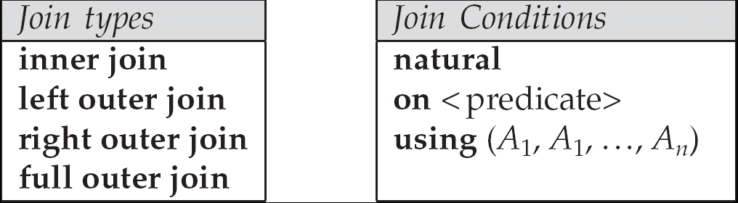
Joined Relations**
Join operations take two relations and return as a result another relation.
These additional operations are typically used as subquery expressions in the from clause
Join condition – defines which tuples in the two relations match, and what attributes are present in the result of the join.
Join type – defines how tuples in each relation that do not match any tuple in the other relation (based on the join condition) are treated.

Slide 45
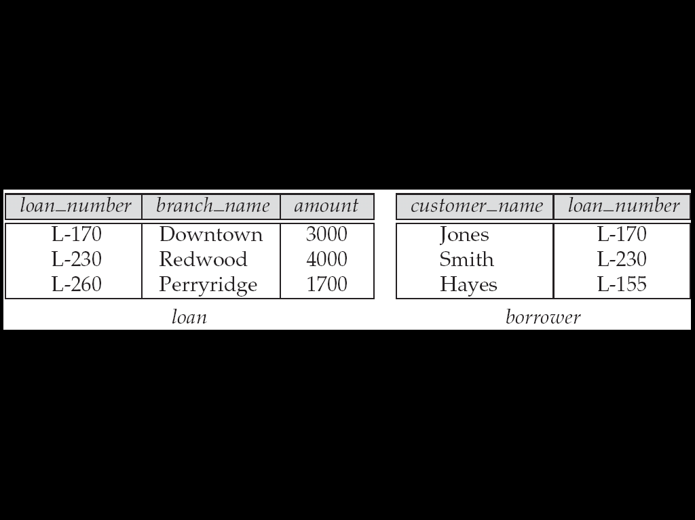
Joined Relations – Datasets for Examples
Relation loan
Relation borrower
Note: IDENTIFY information missing

Slide 46
Joined Relations – Datasets for Examples
Relation loan
Relation borrower
Note: borrower information missing for L-260 and loan information missing for L-155

Slide 47
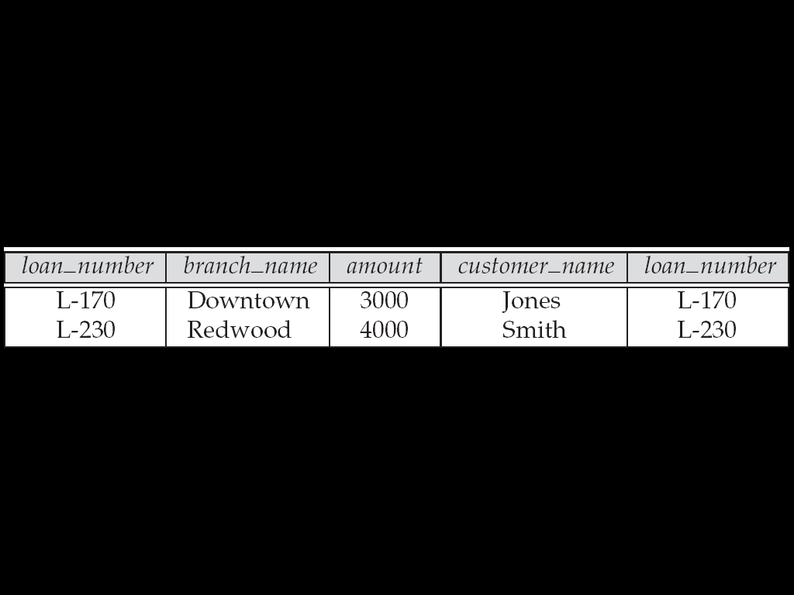
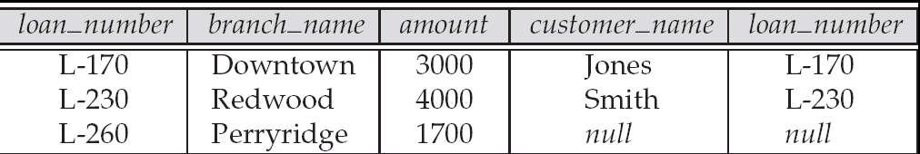
Joined Relations – Examples
loan inner join borrower on loan.loan_number = borrower.loan_number
loan left outer join borrower on loan.loan_number = borrower.loan_number

Slide 48
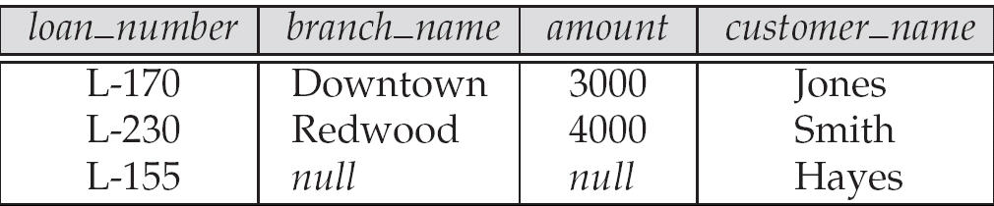
Joined Relations – Examples
loan natural inner join borrower
loan natural right outer join borrower

Slide 49
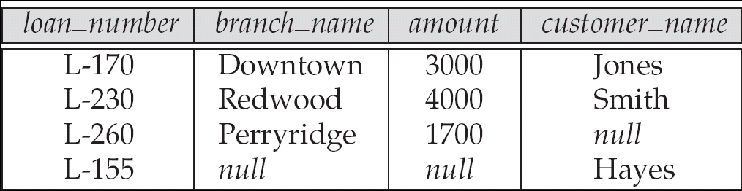
Joined Relations – Examples
Natural join can get into trouble if two relations have an attribute with same name that should not affect the join condition
e.g. an attribute such as remarks may be present in many tables
Solution:
loan full outer join borrower using (loan_number)

Slide 50
Joined Relations – Examples
Find all customers who have either an account or a loan (but not both) at the bank.
select customer_name from (depositor natural full outer join borrower ) where account_number is null or loan_number is null

Slide 51
Select branch , avg(balance)
From (select branch, avg(balance)
from account
groupby branch)
Where avg(balance)>1200

Slide 52
View Definition
A relation that is not of the conceptual model but is made visible to a user as a “virtual relation” is called a view.
A view is defined using the create view statement which has the form
create view v as < query expression >
where <query expression> is any legal SQL expression. The view name is represented by v.
Once a view is defined, the view name can be used to refer to the virtual relation that the view generates.

Slide 53
Example Queries
A view consisting of branches and their customers
create view all_customer as (select branch_name, customer_name from depositor, account where depositor.account_number =
account.account_number )
union (select branch_name, customer_name from borrower, loan where borrower.loan_number = loan.loan_number )
Find all customers of the Perryridge branch
select customer_name from all_customer where branch_name = 'Perryridge'

Slide 54
Uses of Views
Hiding some information from some users
Consider a user who needs to know a customer’s name, loan number and branch name, but has no need to see the loan amount.
Define a view (create view cust_loan_data as select customer_name, borrower.loan_number, branch_name from borrower, loan where borrower.loan_number = loan.loan_number )
Grant the user permission to read cust_loan_data, but not borrower or loan
Predefined queries to make writing of other queries easier
Common example: Aggregate queries used for statistical analysis of data

Slide 55
Processing of Views
When a view is created
the query expression is stored in the database along with the view name
the expression is substituted into any query using the view
Views definitions containing views
One view may be used in the expression defining another view
A view relation v₁ is said to depend directly on a view relation v₂ if v₂ is used in the expression defining v₁
A view relation v₁ is said to depend on view relation v₂ if either v₁ depends directly to v₂ or there is a path of dependencies from v₁ to v₂
A view relation v is said to be recursive if it depends on itself.

Slide 56
View Expansion
A way to define the meaning of views defined in terms of other views.
Let view v₁ be defined by an expression e₁ that may itself contain uses of view relations.
View expansion of an expression repeats the following replacement step:
repeat Find any view relation v_{i} in e₁ Replace the view relation v_{i} by the expression defining v_{i} until no more view relations are present in e₁
As long as the view definitions are not recursive, this loop will terminate

Slide 57
With Clause
The with clause provides a way of defining a temporary view whose definition is available only to the query in which the with clause occurs.
Find all accounts with the maximum balance with max_balance (value) as select max (balance) from account select account_number from account, max_balance where account.balance = max_balance.value

Slide 58
Complex Queries using With Clause
Find all branches where the total account deposit is greater than the average of the total account deposits at all branches.
with branch_total (branch_name, value) as select branch_name, sum (balance) from account group by branch_name with branch_total_avg (value) as select avg (value) from branch_total select branch_name from branch_total, branch_total_avg where branch_total.value >= branch_total_avg.value
Note: the exact syntax supported by your database may vary slightly.
E.g. Oracle syntax is of the form with branch_total as ( select .. ), branch_total_avg as ( select .. ) select …

Slide 59
Update of a View
Create a view of all loan data in the loan relation, hiding the amount attribute
create view loan_branch as select loan_number, branch_name from loan
Add a new tuple to loan_branch
insert into loan_branch values ('L-37‘, 'Perryridge‘)
This insertion must be represented by the insertion of the tuple
('L-37', 'Perryridge', null )
into the loan relation

Slide 60
Updates Through Views (Cont.)
Some updates through views are impossible to translate into updates on the database relations
create view v as select loan_number, branch_name, amount from loan where branch_name = ‘Perryridge’
insert into v values ( 'L-99','Downtown', '23')
Others cannot be translated uniquely
insert into all_customer values ('Perryridge', 'John')
Have to choose loan or account, and create a new loan/account number!
Most SQL implementations allow updates only on simple views (without aggregates) defined on a single relation

Slide 61
Null Values
It is possible for tuples to have a null value, denoted by null, for some of their attributes
null signifies an unknown value or that a value does not exist.
The predicate is null can be used to check for null values.
Example: Find all loan number which appear in the loan relation with null values for amount.
select loan_number from loan where amount is null
The result of any arithmetic expression involving null is null
Example: 5 + null returns null
However, aggregate functions simply ignore nulls
More on next slide

Slide 62
Null Values and Three Valued Logic
Any comparison with null returns unknown
Example: 5 < null or null <> null or null = null
Three-valued logic using the truth value unknown:
OR: (unknown or true) = true, (unknown or false) = unknown (unknown or unknown) = unknown
AND: (true and unknown) = unknown, (false and unknown) = false, (unknown and unknown) = unknown
NOT: (not unknown) = unknown
“P is unknown” evaluates to true if predicate P evaluates to unknown
Result of where clause predicate is treated as false if it evaluates to unknown

Slide 63
Null Values and Aggregates
Total all loan amounts
select sum (amount ) from loan
Above statement ignores null amounts
Result is null if there is no non-null amount
All aggregate operations except count(*) ignore tuples with null values on the aggregated attributes.

Slide 64
End of Chapter 3

Slide 65
The where Clause (Cont.)
SQL includes a between comparison operator
Example: Find the loan number of those loans with loan amounts between $90,000 and $100,000 (that is, ≥ $90,000 and ≤ $100,000)
select loan_number from loan where amount between 90000 and 100000
Notes:
7

Slide 66
Figure 3.1: Database Schema
branch (branch_name, branch_city, assets)
customer (customer_name, customer_street, customer_city)
loan (loan_number, branch_name, amount)
borrower (customer_name, loan_number)
account (account_number, branch_name, balance)
depositor (customer_name, account_number)

Slide 67
Definition of Some Clause
0
(5 = some
) = true
5
0
(5 ≠ some
5
) = true (since 0 ≠ 5)
(= some) ≡ in
However, (≠ some) is not equivalent to not in

Slide 68
Definition of all Clause
0
(5 < all
5
) = false
6
6
(5 < all
) = true
10
4
(5 = all
) = false
5
4
(5 ≠ all
) = true (since 5 ≠ 4 and 5 ≠ 6)
6
(≠ all) ≡ not in
However, (= all) is not equivalent to in

Slide 69
Test for Empty Relations
The exists construct returns the value true if the argument subquery is nonempty.
exists r ⇔ r ≠ Ø
not exists r ⇔ r = Ø

Slide 70
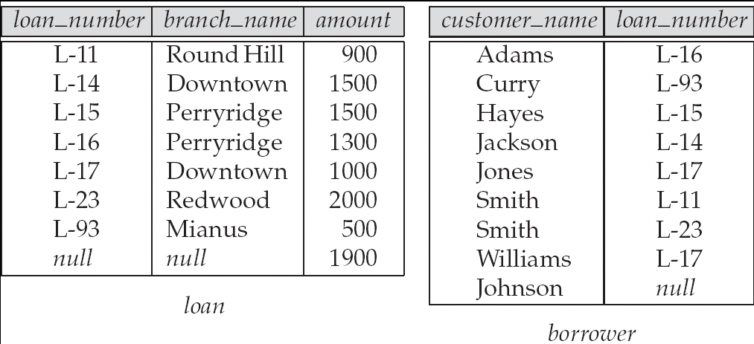
Figure 3.3: Tuples inserted into loan and borrower

Slide 71
Figure 3.4: The loan and borrower relations

